Slide 1

Language Movement (1948 and 1952)

Slide 2
Submitted by –
Abrar Hossain Zahin
ID# 2022-2-60-040
Submitted to – Ashit Boran Paul (DABP)

Slide 3
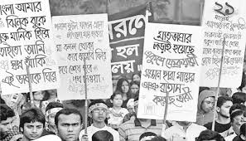
Background of Language Movement
The question about the issue of state language was raised immediately after the creation of Pakistan.
The central government of Pakistan forcedly declared "Urdu" as the
only state language.
The intellectuals & people of all classes started to raise their voice & it soon converted into a mass movement.

Slide 4
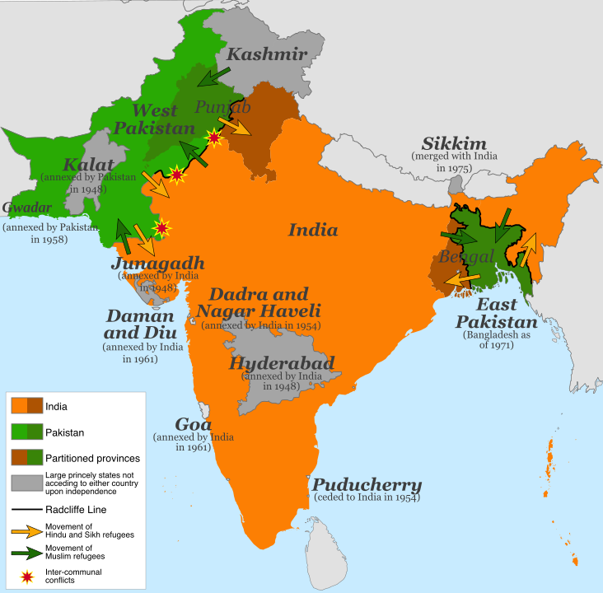
Background of Language Movement

Slide 5
Background of Language Movement
Social & Cultural causes :
﻿﻿Language is the crucial part of any culture.
﻿﻿"Urdu" Failed to represent our culture.
Political Causes :
﻿﻿Bangla must be lifted to achieve freedom in real sense.
﻿Domination of any alien language is the worst kind of domination.
The mistake became a weapon.

Slide 6
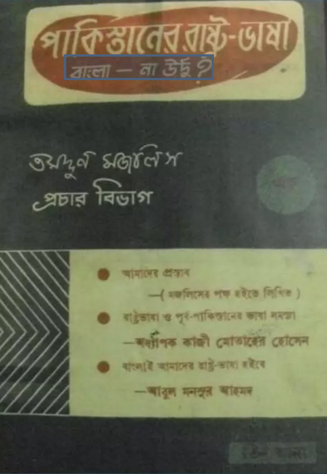
Background of Language Movement
1947 :
September 2 : Abul Kashem, founded Tamaddun Majlish, a non- political literary and cultural organization, to mobilize students, intellectuals, and the general people in support of the Bengali language as a state language in Pakistan. Tamaddun Majlish published a pamphlet. "Pakistaner Rashtrobhasha Bangla na Urdu?"

Slide 7
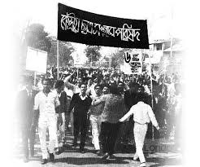
Background of Language Movement
1947 :
December 6 :
Teachers & students of the University of Dhaka demanded Bangla as an official Language.
December 30 :
First "Rashtrobhasha Sangram Parishad” Tamaddun's Professor Nurul Haque Bhuiyan.

Slide 8
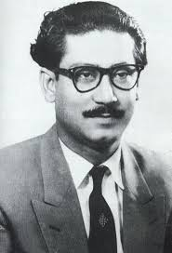
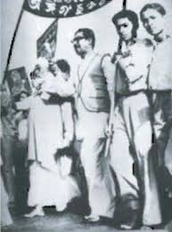
Background of Language Movement
11 March 1948 :
A general strike was observed in the towns of East Pakistan in protest against the omission of Bangla from the languages of the Constituent Assembly. Amidst processions, picketing and slogans, leaders such as Shawkat Ali, Kazi Golam Mahboob, Shamsul Huq, Oli Ahad, Sheikh Mujibur Rahman, Abdul Wahed and others were arrested. Student leaders, including Abdul Matin and Abdul Malek Ukil, also took part in the procession and picketing.

Slide 9
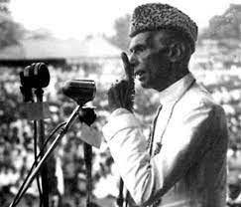
Background of Language Movement
1948 :
March 21 :
Md. Ali Jinnah, the Governor General of Pakistan, Declared, "Urdu and only Urdu" as the state language of Pakistan in Ramna Racecourse (Suhrawardy Uddan), Dhaka, East Pakistan.

Slide 10
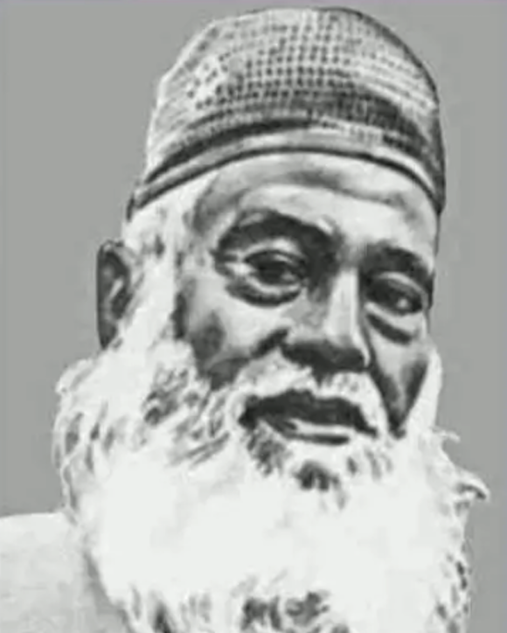
Background of Language Movement
1948 :
March 24 : Again Jinnah Declared, "Urdu and only Urdu" as the only state language of
Pakistan in Curzon hall. Then the present students protested by crying out collectively "no, no" in loud voice.
1949 :
June 23 : Awami Muslim League was formed by Mwaulana Abdul Hamid Khan Bhashani.

Slide 11
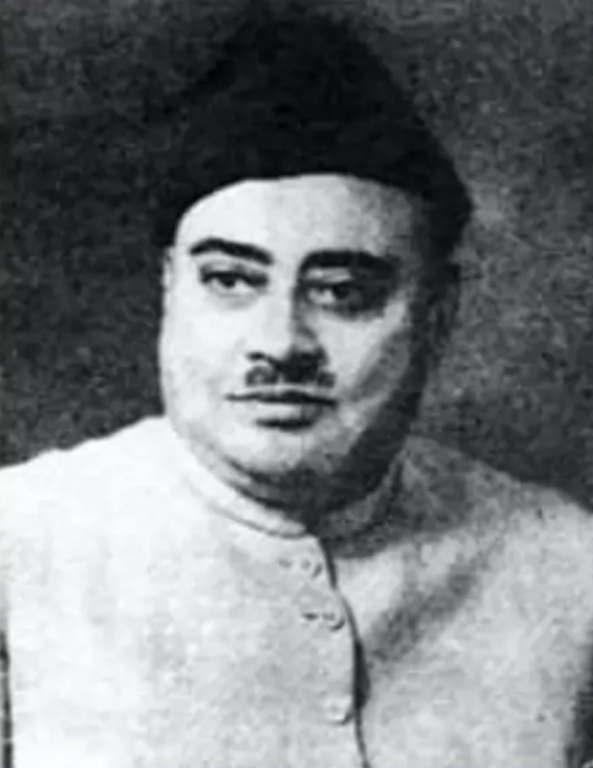
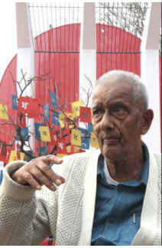
Background of Language Movement
1952 :
January 26 : Nazimuddin declared "Only Urdu" as
the state language in Paltan Maidan, Dhaka. This enraged the people of East Pakistan.
February 4 : Adbul Matin formed "Dhaka University's State Language Committee" in Language protest.
Shorbodolio Kendrio Rashtrobhasha Kormi Porishod decided to declare February 21 as the day for strikes throughout the province terming the day as "Bhasha Dibosh" (Language Day). Gaziul Haq and Adbul Matin led student procession.

Slide 12
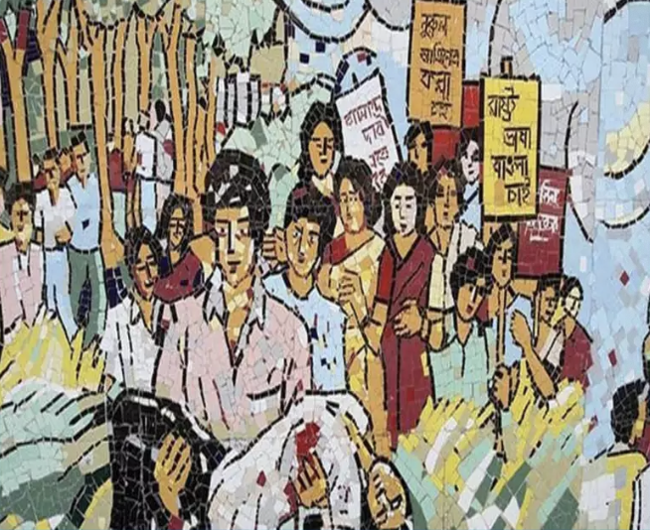
Background of Language Movement
1952 :
Febryary 20 :
Section 144, banning all processions & meetings for the next 30 days.
Febryary 21 :
The students were determined to violate Section144 and held a student meeting at 11.00 am on the Dhaka University campus, then located close to the Medical College Hospital.

Slide 13
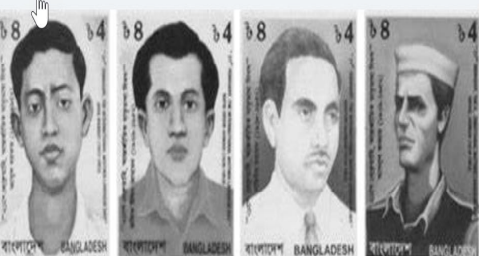
Background of Language Movement
February 21 :
Thousands of students from different schools and colleges of Dhaka assembled on the university campus while armed police waited outside the gate. Police opened fire and killed a number of students, including Abdus Salam, Rafiq Uddin Ahmed, Barkat and Abdul Jabbar. A nine-year-old boy named Ohiullah was also killed.

Slide 14
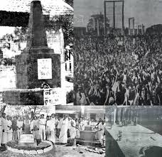

Significance of Language Movement
Decided to commemorate 21 February as
Shohid Dibosh by the Shorbodolio Kendrio Rahstrobhasha Kormi Porishod.
﻿﻿February 29, 1956 :
﻿﻿Recognition made on the constitution that
“The state language of Pakistan shall be Urdu
and Bengal”.
﻿﻿This movement laid a maior foundation of our liberation war.
Finally, 17 November, 1999, the UNESCO
General Convenience recognized 21 February
as International Mother Language Day.

Slide 15
Significance of Language Movement
The supreme sacrifice of the martyrs of the language movement on February 21st (1952) became an depth of the inspiration for sustaining self-consciousness and dignity as a nation. The motivation of language movement struggle we were able to achieve the independence of Bangladesh.
1). Nationalism was awakened within the Bengalis,
2). The emergence of self-rule consciousness in 1954 general
election,
3). Student movement in 1962,
4). 6-point movement,
5). Uprising in 1969 and, subsequently,
6). The election of 1970,
7). The Bangladesh Liberation War in 1971.

Slide 16
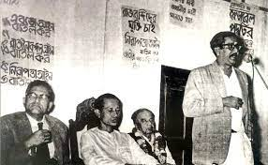
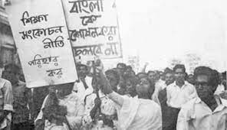
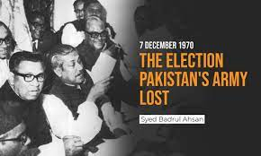
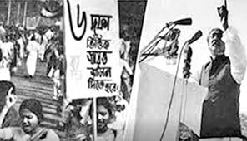
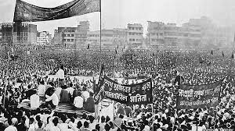
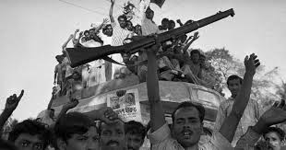
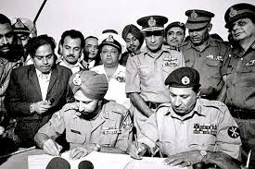
Significance of Language Movement

Slide 17
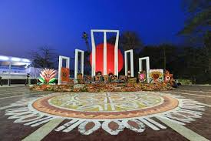
Thank You
For
Watch My Presentation

